Slide 1
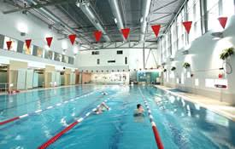
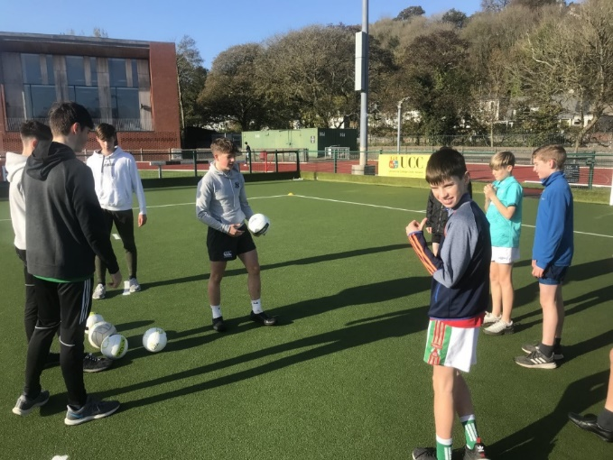
TY Modules
Mission Statement
“To promote the personal, social, vocational, and educational development of students and to prepare them for their role as autonomous and participative members of society”
Be the best person that you can be!

Slide 2
TY Management Team
Ty Coordinator | TY Year Head | TY Senior Management Lead | TY Careers
TBC | Brian McMahon | Aiden Twomey | Emmet O’Halloran
ty@pbc-cork.ie |  | aiden.twomey@pbc-cork.ie | emmet.ohalloran@pbc-cork.ie
Modules/TY Activities | Attendance/Discipline | Attendance/Discipline | Careers Planning

Slide 3
Calendar 2022 - 2023
The calendar of events will be confirmed once the school timetable is completed during the summer holidays.

Slide 4
Work Experience
Dates will be confirmed once Calendar is set
You must find your own placement
Worthwhile
Practical experience of the real world
2 Weeks
All associated forms are on the College Website in the TY NEWS section

Slide 5
Social Work
You must find your own placement
Worthwhile
A chance to give back to your community
Builds self esteem
Practical experience of the real world
Practical Christianity
1 Week
Garda vetting may be required by your social work provider- you can only be Garda vetted if you are 16 yrs of age. You can not apply in advance only on or after your 16th Birthday . The application for vetting is available from the TY Coordinator and is submitted to the school office and NOT directly to The Gardai
New experiences

Slide 6
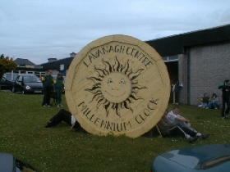
Social Work

Slide 7
Examples of Placements
C.O.P.E.
Day-care Centre`s for the elderly such as Westgate Foundation
SHARE
Children’s day-care centre, St. Mary’s Of The Isle
Meals-On-Wheels
Penny Dinners
New experiences

Slide 8
How the Modules work.
TY Modules are divided into two sections
Full year Modules. Each student chooses one module from the Full year module list and he takes that module for the full academic year. This takes place over 1 period a week
Half Year Modules. Each student chooses two modules, one to be taken from August to December and the other to be taken from January to May. They take place over a double period.

Slide 9
Modules Application Form
A Questionnaire to choose your Modules is included in this email
Please read through this PowerPoint with your Son before completing the Questionnaire
The form asks you to rank your choices in order of preference, we will endeavour to offer your son his number 1 choice however number limitations apply to certain modules see detailed listing below

Slide 10
Full Year Modules
1. Barista Level 1 & 2
2. CAD
3. Enterprise
4. Scientific Investigation
5. Japanese
6. Journalism
7. Young Social Innovator

Slide 11
1. Barista Full Year Level 1 & 2 and culinary skills.
This is a high demand module however there are only 12 places available.
There is a course fee of €120 and this covers ingredients for the meals being created by the boys and exam fees for level 1 and 2 Barista qualifications, these qualifications are internationally recognised.
This is the 2nd year of this popular module and the 1st year that it is being offered as a full year module.
This is an off campus module which takes place in Mode Café on Washington Street.

Slide 12
2. Introduction to Computer Aided Design
· Introduction to CAD & Google Sketchup
· Google Sketchup basics and 3D modelling
· Classroom lead and self-paced CAD design tutorials.
· Design assignments.
· Architectural design review
· Surveying
· Architectural project design
· Model building.

Slide 13
SketchUp
SketchUp is a 3D modelling computer program for a wide range of drawing applications such as architectural, interior design, landscape architecture, civil and mechanical engineering, film and video game design
(https://www.sketchup.com/programs/sketchup-story )

Slide 14
Aims & Contents
Aims
Contents
To introduce and give the students experience of Computer Aided Design.
To develop students IT fluency.
To promote problem solving.
To develop team work and communication
Introduction to CAD & Google Sketchup
Google Sketchup basics and 3D modelling
Classroom lead and self-paced CAD design tutorials.
Design assignments.
Continuous classroom assessment
Design Exercise Assignment
Final design exam
End of project model build

Slide 15
Note on CAD
To allow for differentiation between the students the class works on a much more open structure. All students will be introduced to sketchup as a class but there after a community of learners approach is employed.
The teacher’s role is as an advisor and supervisor. The students will work in an open plan office setup where students will work alone or in groups as required.
Students are encouraged to look for help from each other an online. This setup is ideal as the students work in an environment very similar to real life. Help from the teacher is regarded as the final step.

Slide 16
3. Enterprise Education & Mini Company
Taking this module will allow you to figure out what it takes to set up & run your own business.
You will work hard in teams to try and bring your idea to life and you will learn from first-hand experience what it takes to make a business a success.

Slide 17
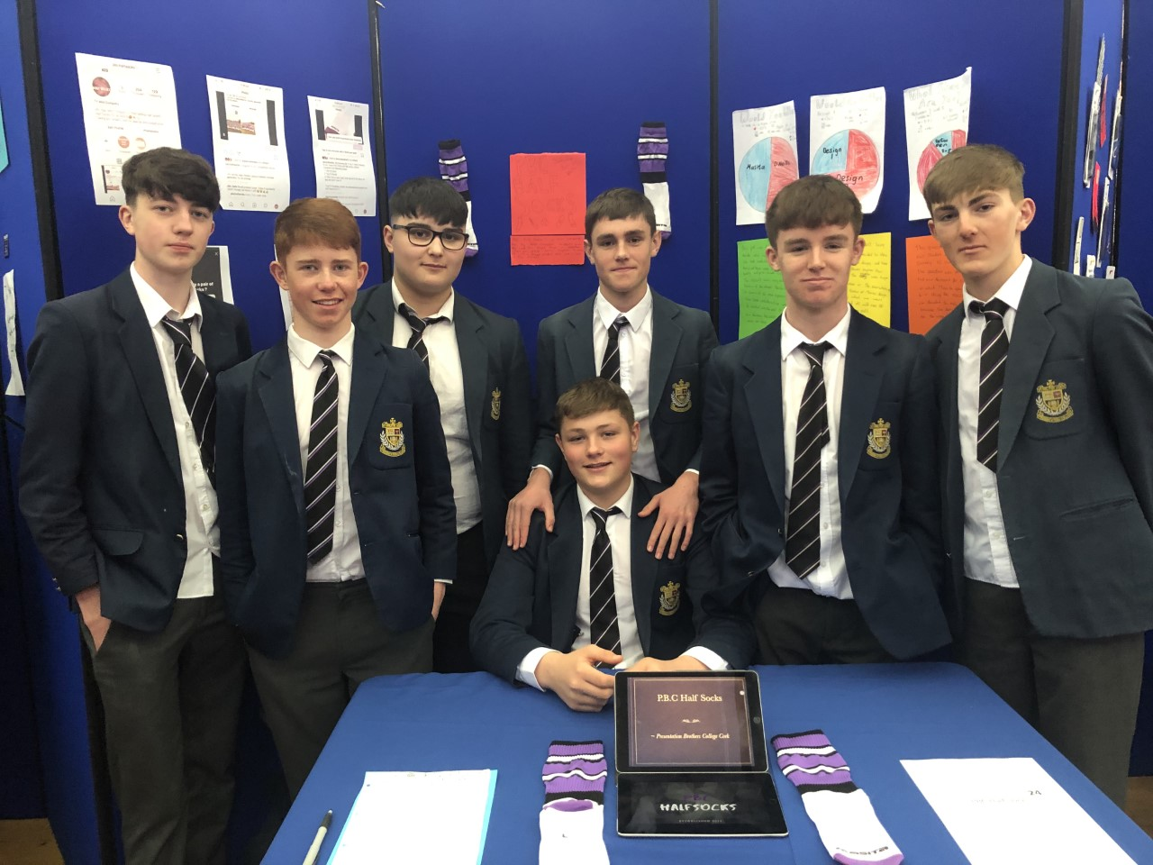
Enterprise Education
Could you be Ireland’s next big Entrepreneur?

Slide 18
Enterprise Trade Fair Press Launch

Slide 19
As you go through the year, you will think of a creative new enterprise, identify your target audience, market the good or service and sell as many units as possible, all while hoping to make a profit.
Each person in your team will take on a different role (such as Managing Director, Production Manager, Marketing Manager) and by the end of the year you will appreciate being in a group with hard-working people!

Slide 20
Enterprise Education
Over the course of the module you will welcome guest speakers to the class who will help you with different aspects of your business. You can also attend trade fairs where you can showcase your product to the wider public in Cork and workshops where you will meet with entrepreneurs from other schools.

Slide 21
People who work hard in this module develop the necessary skills to survive in the business world and it is a very rewarding module for those who are willing to put the work in.

Slide 22
4. Scientific investigation

Slide 23
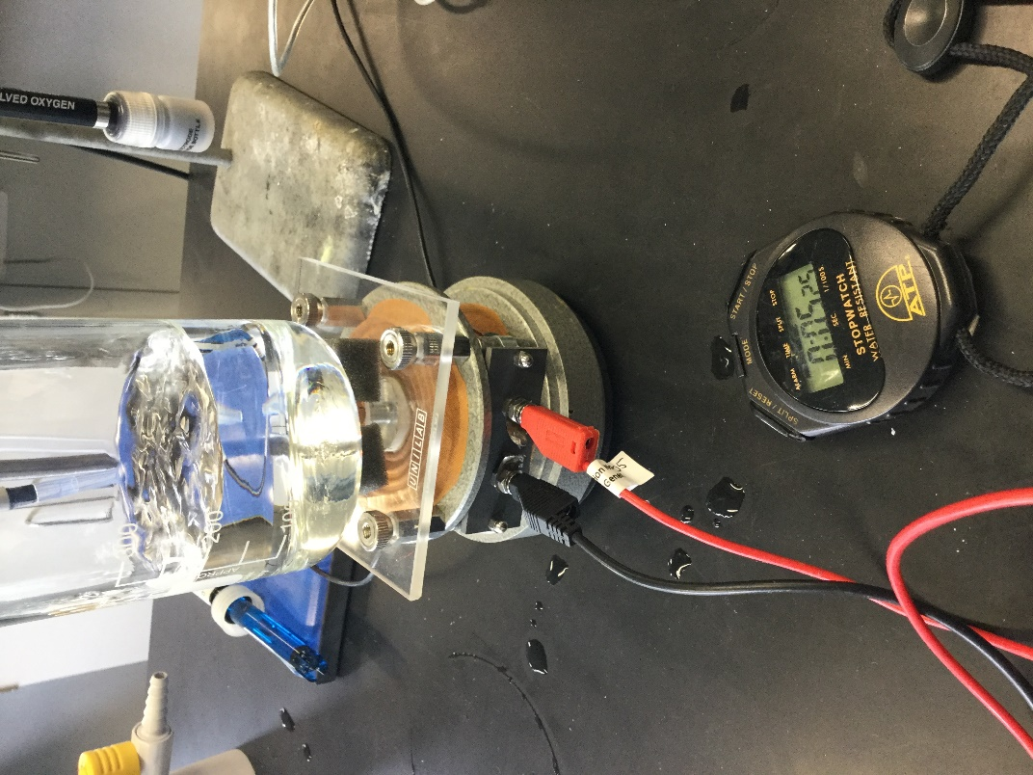
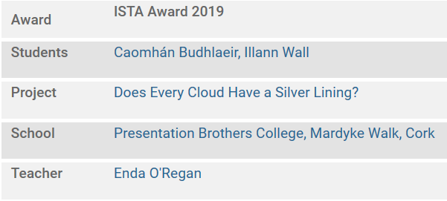
Building on the success of reaching a national Final !

Slide 24
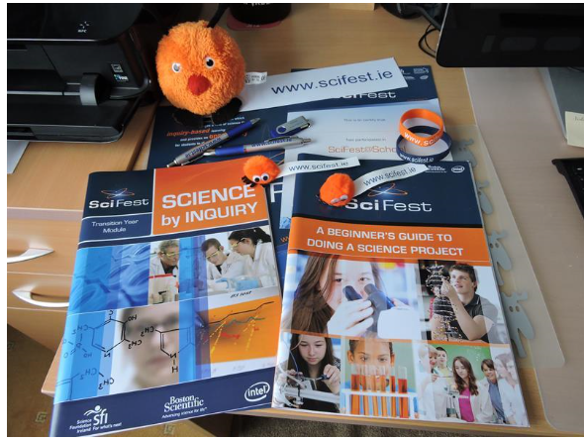
We have a well resourced module supported by Scifest

Slide 25
WHERE THE SCIENTIFIC METHOD IS FOLLOWED
Making observations
Forming a hypothesis
Carrying out experiments
Publishing your results
Accepting
Observing the results
Rejecting
Forming a theory
www.scifest.ie
© Sheila Porter – SciFest@School

Slide 26
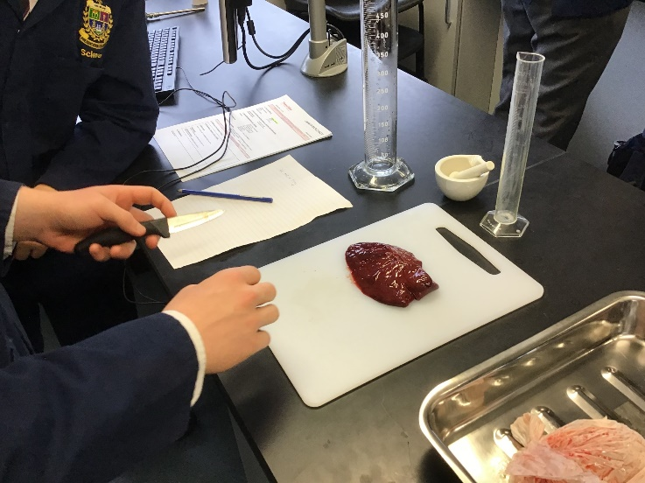
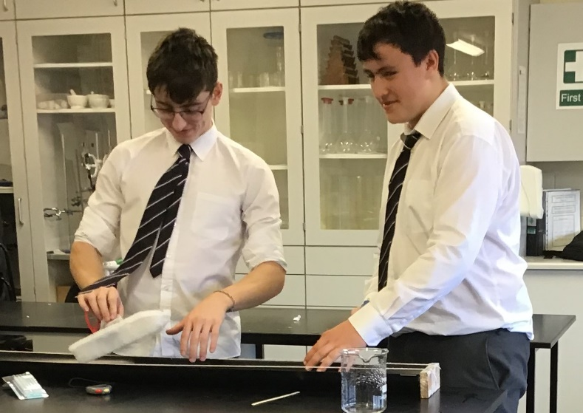
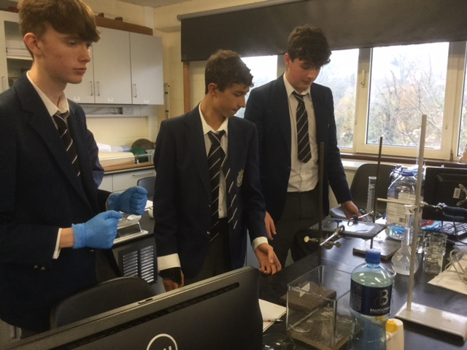
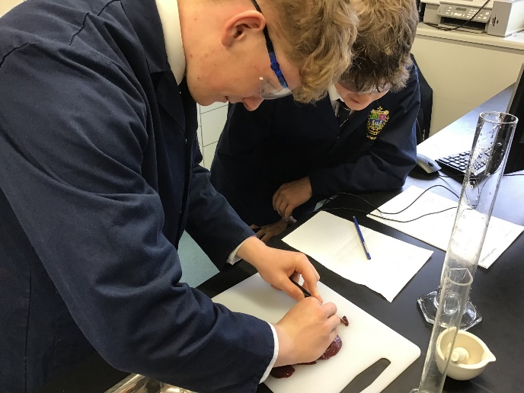
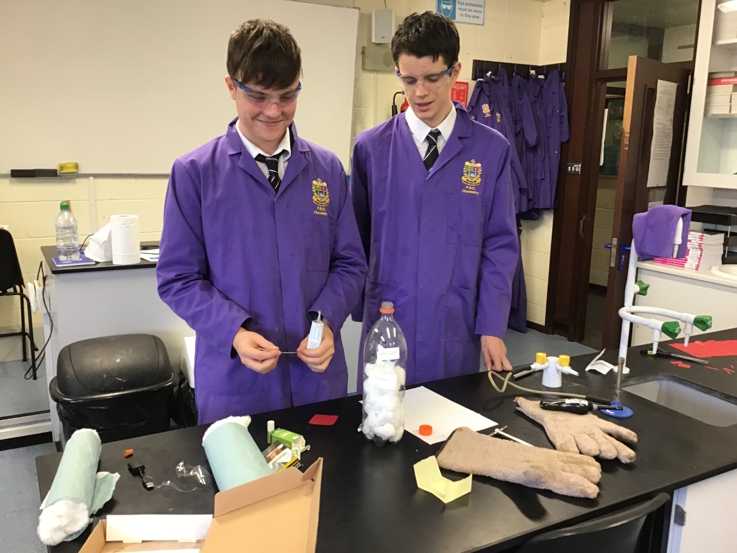
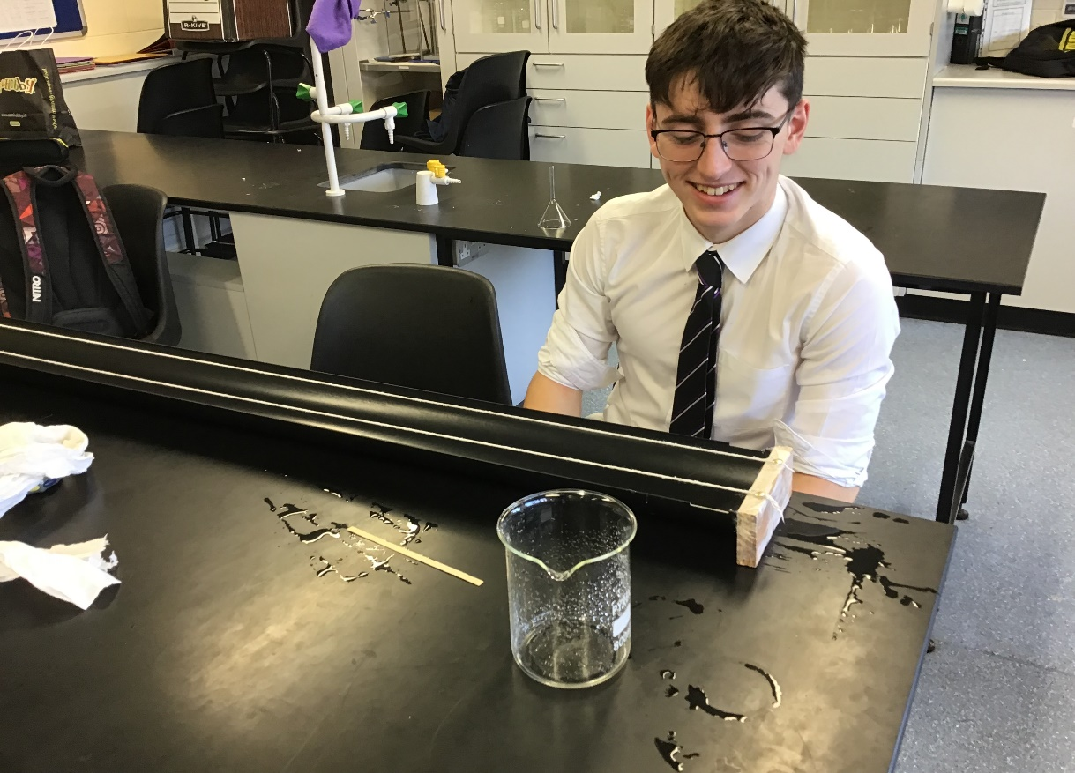
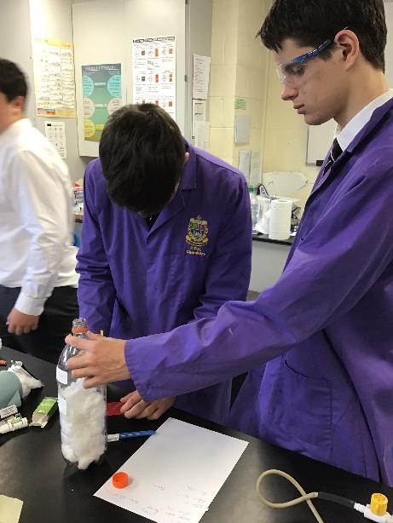
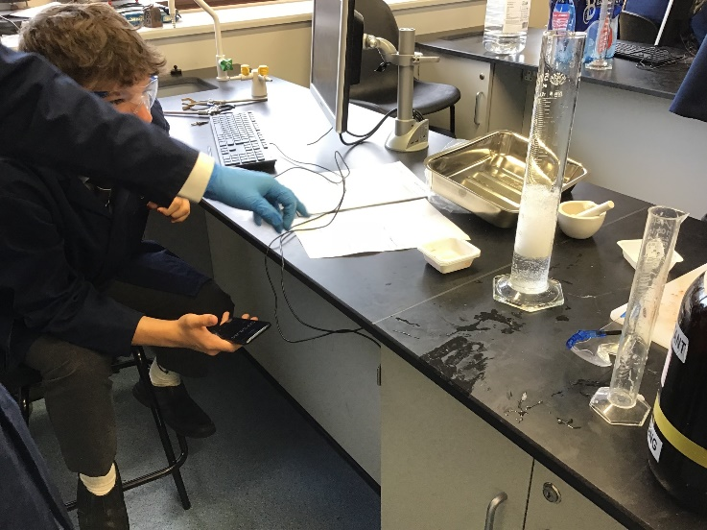
Students design and carry out their own experiments

Slide 27
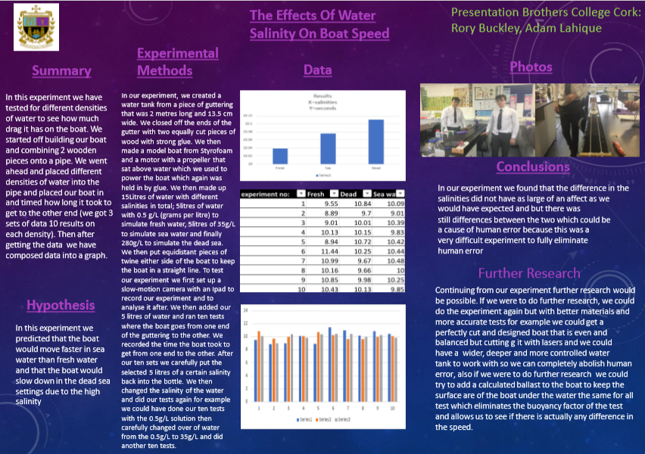
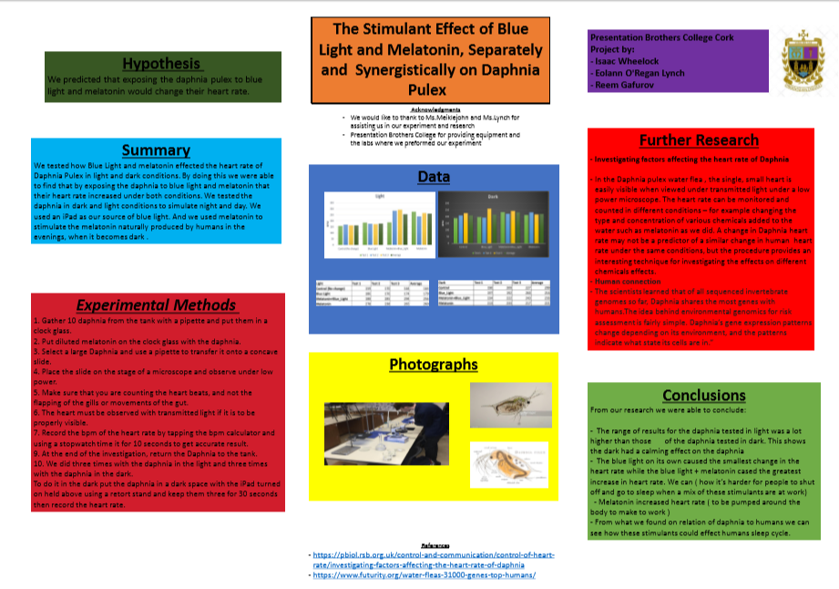
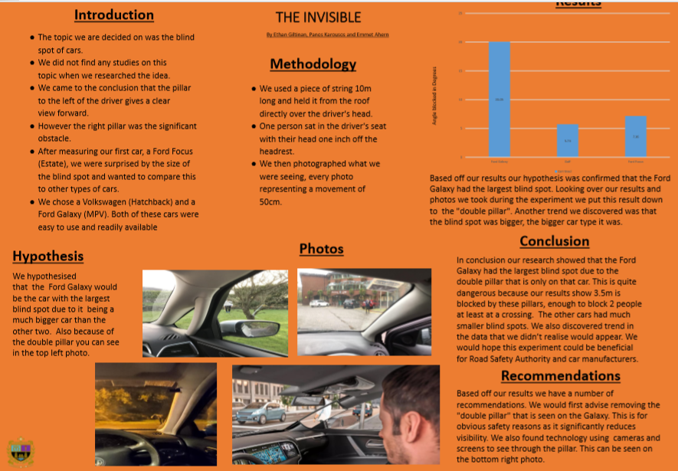
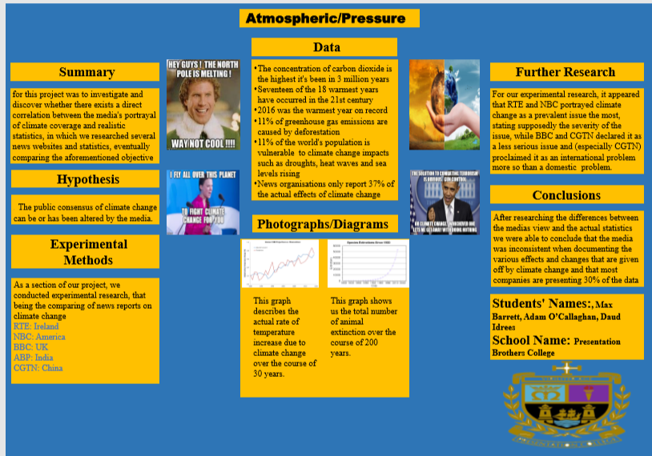
Communicate them with the scientific community

Slide 28
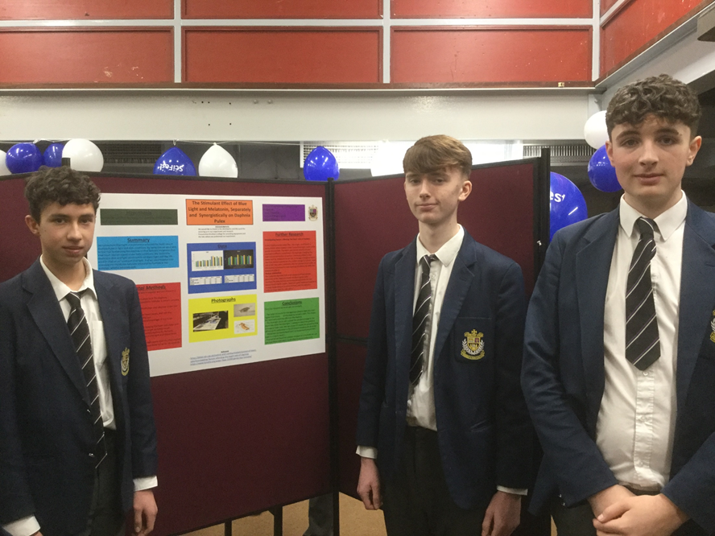
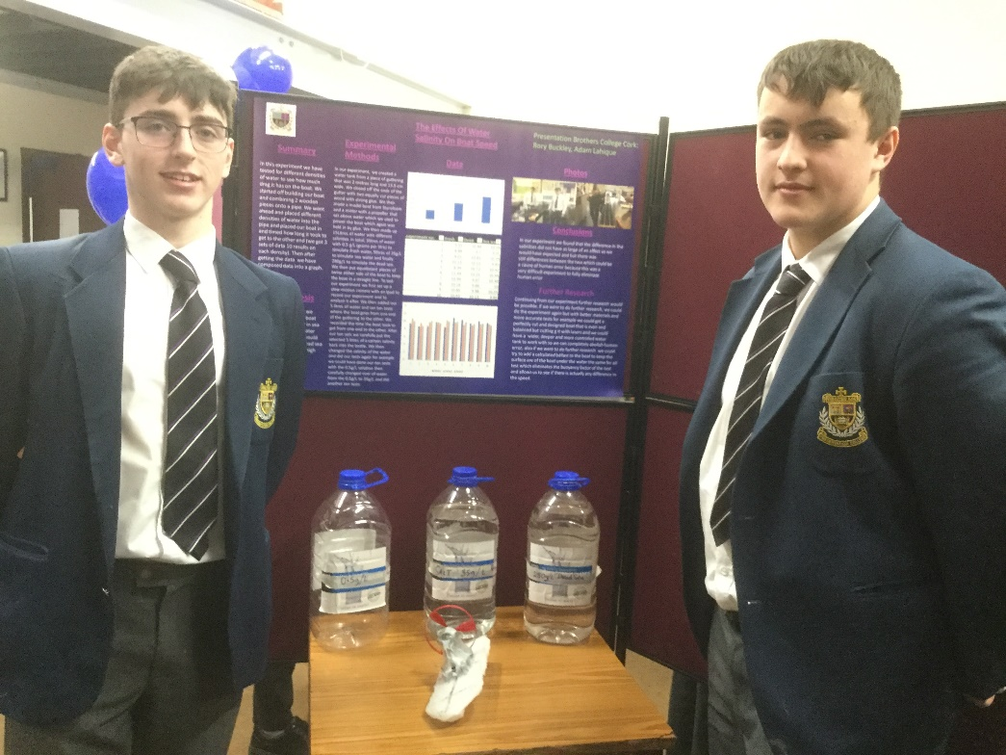
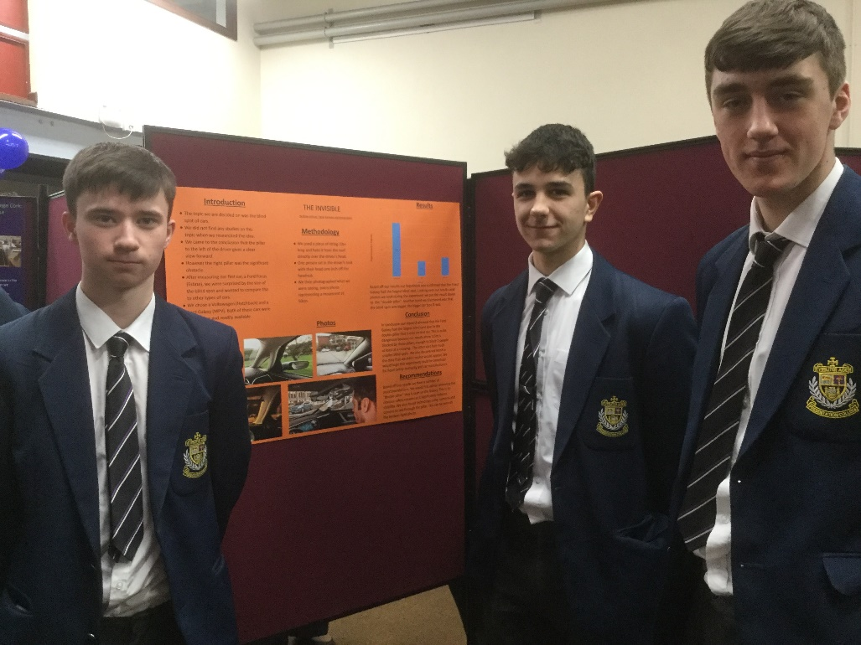
In PBC

Slide 29
5. What a Japanese TY class is like:
A double, usually once a week. The class will vary and adapt to the needs of the students, a bit of language and culture interspersed with activities, games and crafts.
Events: All Ireland Japan Quiz – end of January, especially for TY students.
Visit to a Japanese restaurant, spring term.
Below is an embedded video, please enjoy.
https://www.youtube.com/watch?v=WLIv7HnZ_fE&t=3s

Slide 30
Japanese Module
Presentation Brothers College is one of the few schools which offer its students the opportunity to discover the richness, uniqueness and diversity of the Japanese culture. This module runs for the whole academic year, thereby allowing the students time to not only learn basic language skills, but to encourage independent thinking and enable students to talk about various topics.

Slide 31
Japanese TY Group

Slide 32
If students want to select Japanese for the Leaving Cert., TY gives them a spring-board so that they would be well prepared for 5th & 6th yr.
Language: Students will learn everyday greetings, they will be able to introduce themselves and their family, and ask and answer simple questions.
They will be able to speak in Japanese on simple topics such as family, pets, hobbies, sport, food, school and countries.
Learn to count and write Japanese numbers, be able to write name in Japanese.
Cultural: Students will understand about Japanese etiquette, be able to talk generally about Japan, its geography, climate, population, industry, religion, its countless festivals, music and fashion, pop culture, manga and anime, food, etc....

Slide 33
Japanese
Congratulations to our TY Japanese Quiz team on their victory in the All Ireland and to their teacher Ms Rhonda Tsu Lambe

Slide 34
6. Journalism & Radio
This is a very exciting course and well worth consideration
Press Pass is designed specifically to enable students to learn all about newspapers and the writing, analysis, preparation and photography involved in putting one together.
Students will become familiar with the five language types which form the basis of study for Leaving Certificate English Paper 1 in a very practical way: languages of Information, Argument, Narration, Persuasion as well as the Aesthetic Use of Language.
It is envisaged that students will visit the offices of The Irish Examiner and spend some time with editing and sub-editing staff to see how a daily newspaper is produced.
Students will have an opportunity to focus on current issues, current affairs, current trends and creative writing ; they will be expected to write, edit and produce a school magazine
Radio is a new addition where students look at Radio production and online media

Slide 35
7. Young Social Innovator
The Social Innovation Action Programme is a youth led, team based, action focused programme for young people. Working in teams, social innovators are challenged to identify a social issue affecting them, their communities or wider society and to come up with and implement creative solutions. Each year, thousands of young people throughout Ireland tackle issues such as equality, poverty, exclusion, human rights, safety and the environment.
If you are interested in politics and changing your world then this is the module for you!
For a greater understanding visit the YSI website
Click here to View YSI Website

Slide 36
Half Year Modules
Barista Level 1
Photography
Chinese
Introduction to Law
Video Analysis for Sport
Survive and Save, and Life Support Module
Rugby Coaching
ICDL

Slide 37
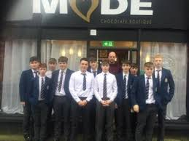
1. Half Year Barista & Culinary Skills
This is a high demand module however there are only
12 places available.
This a half year module and places will be offered again in January
There is a course fee of €80 euro and this covers ingredients for the meals being created by the boys. ( which they get to eat )
The €80 also covers exam fees for the level 1 Barista qualification, this qualification is an internationally recognised qualification.
This is an off campus module which takes place in Mode Café on Washington Street.

Slide 38
2. Photography
Please see the attached PowerPoint for an overview of the photography Module

Slide 39
3. Chinese
Module Objective: This Chinese module for Transition year is based on HSK level 1, learner centred, and aims to enable TY students to reach basic levels in speaking, listening and reading Modern Standard Chinese (MSC), and it also develops their perceptual training skill in order to perceive Chinese tones. In addition, it promotes their cultural and intercultural awareness, and stimulates them to plan and evaluate their progress in learning MSC in the future.
This course is run by the UCC Asian studies department in conjunction with Chinese - Teaching Chinese to Speakers of Other Languages (MATCSOL)team, UCC Centre for Chinese Studies. Certified Course
Course features: Total Hours 48, Total Units: 12.

Slide 40
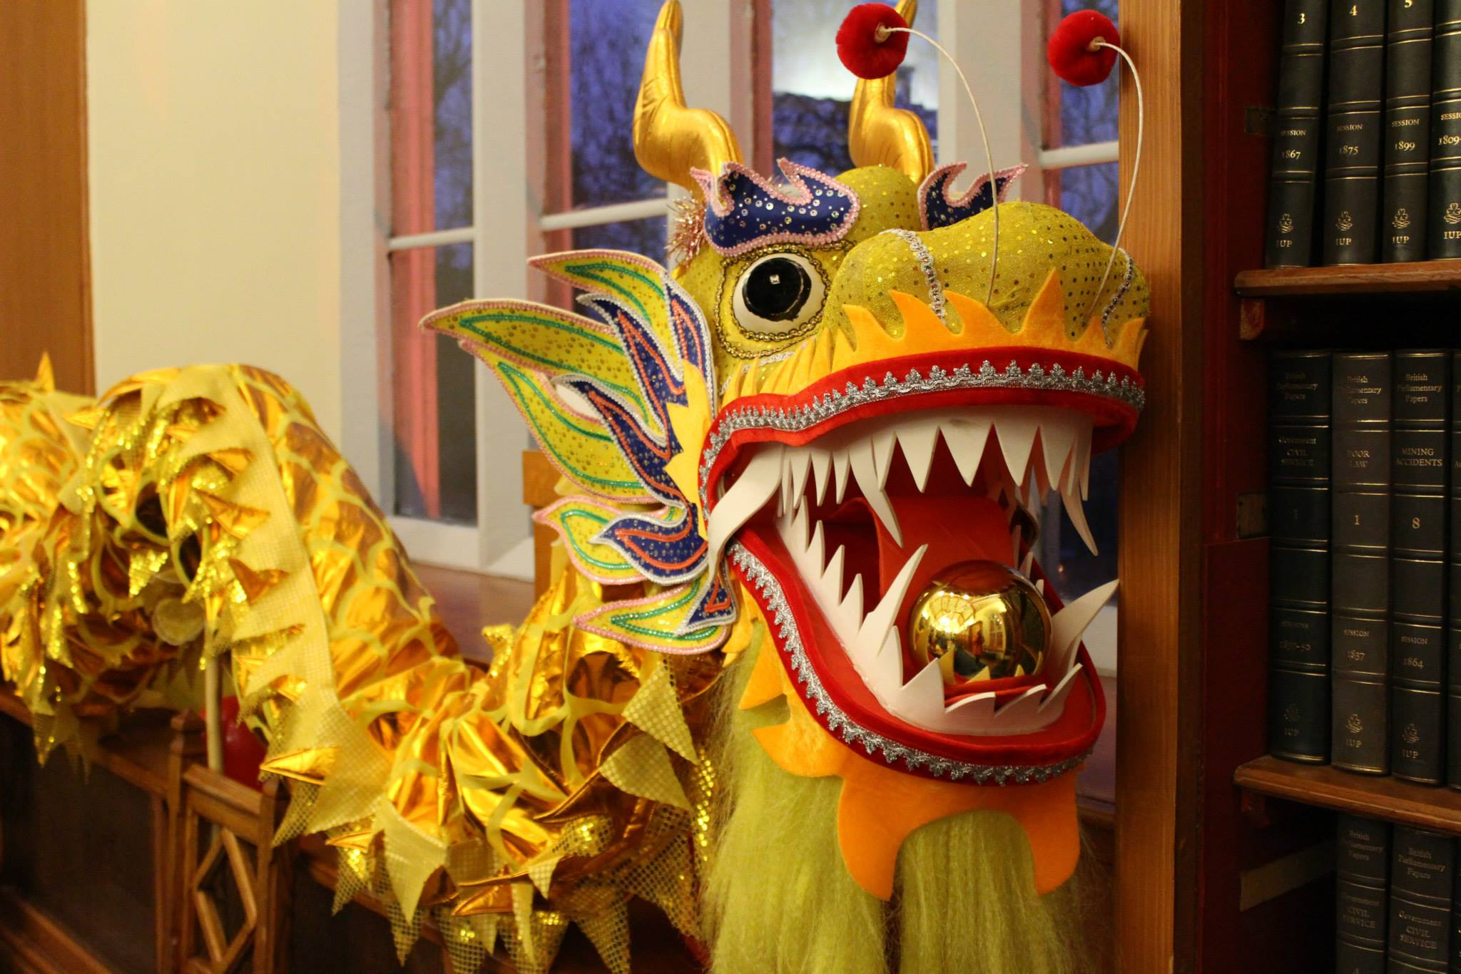
Chinese
Unit 1: Personal greetings
Unit 2: Exchange certain personal information
Unit 3: Family and hobbies
Unit 4: Sharing information and daily life
Unit 5: Time and birthday.
Unit 6: Weather, location and transportation.
Unit 7: Chinese New Year and going out for a Chinese meal.
Unit 8: Going shopping.
Unit 9: Looking for places and making phone calls.
Unit 10: Quantification
Unit 11: Out of class time.
Unit 12: Self-introduction in Chinese.

Slide 41
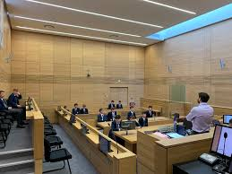
4 . Introduction to Law
This module gives the students a brief introduction into the Irish legal system. We start by looking at the history of the Irish legal system and the different courts in Ireland.
During the module we examine the difference between Civil and Criminal law, we look at the Separations of powers, explore the old common law system and understand the principle of precedence.

Slide 42
We study the various laws including Tort, Contract, Criminal and Property as well as looking at some Constitutional rights. The students will get an opportunity to see and engage with case law in these different areas.
There is also a guided tour of the courts during the module and we will have a guest speaker come in to speak to the students.

Slide 43
For any students considering a career in Law this is a wonderful opportunity for them to explore and understand the law and the legal profession in Ireland.
( 24 places available in this module per term.)

Slide 44
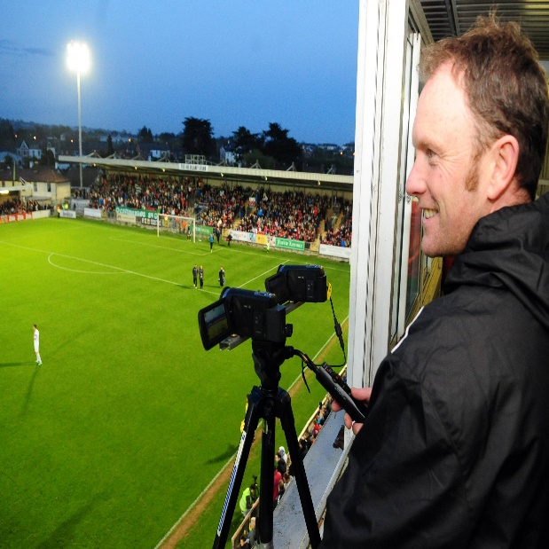
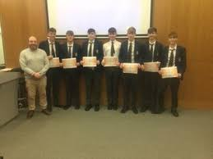
6. Video Analysis for Sport
Practical use of applicable software’s in groups and individual learning
Group work in identifying Key Performance Indicators (KPIs)
The use of camera equipment in a game\training environment (optional)
Presentation of short project in an aspect of play using KPIs
Work with senior teams in all sporting codes ( GAA, Rugby, Cricket, Soccer)
Live game analysis experience (if possible)
Apply what you learn to your favorite sport
This is a UCC Mardyke Arena certified course.

Slide 45
7. TY Survive and Save, and Life Support Module
The Survive and Save programme is a lifesaving awards programme
The awards are challenging but fun to complete and they are arranged into Bronze and Silver levels to ensure that you continue to develop your
lifesaving skills as you progress through the
awards.

Slide 46
Skills acquired
lifesaving rescue,
self-rescue
survival,
lifesaving sport skills
develop swimming ability and fitness.

Slide 47
Life Support covers the basics of how to
perform CPR,
the diagnosis and treatment for Choking
Bleeding and Shock on an Adult Casualty

Slide 48
What’s covered in the award syllabus?
Awareness of own safety
· Turning a casualty onto their back
· Checking responsiveness
· Sequence and application of CPR
· Managing regurgitation
· Recovery position
· Diagnosis and treatment of choking

Slide 49
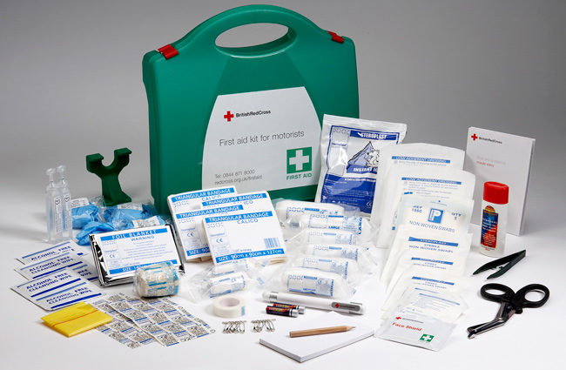
Optional First aid:
Diagnosis and treatment of bleeding
·Diagnosis and treatment of shock

Slide 50
8. Rugby Coaching & Refereeing Module
The TY Coaching Module gives students the opportunity to develop their coaching skills through a combination of coaching lessons and first-hand experience of coaching young players.
Students will also enjoy multiple coaching workshops from external speakers including Munster Rugby Development Officer, Owen Maloney and I.R.F.U Referee Development Manager, Chris Harrington.

Slide 51
This module is specifically designed for Transition Year Students to introduce them to the concepts of coaching, with an emphasis on coaching Mini rugby (U8 – U12) where players are being introduced to rugby for the first time and participating in games of Tag Rugby with reduced numbers.
The focus is on the students learning basic coaching concepts and applying them practically in a realistic coaching environment.
There is an emphasis on the coach learning how to develop a players’ all-round skills and game-understanding. These general concepts would apply to many other sports and a rugby background is not essential to complete this course.

Slide 52
In the first phase of the module (4 weeks) the coaches learn basic coaching theory. In the second phase (8 weeks) the coaches apply this theory practically by coaching Primary School from students (St Joesephs) while continuing to develop their theoretical knowledge of coaching concepts. On the final week of the module the coaches organise a tournament for the same Primary School students they have been coaching. This process allows the coaches to observe the development of the players’ abilities over a period of time and hence to assess their own effectiveness as coaches.
On completion of the module and subject to having been found suitable through continuous assessment the coaches are awarded a certificate by Munster Rugby.
Important Note: Coaches aged 16-18 yrs old are restricted to performing in an Assistant Coach role, under the direct supervision and guidance of an Accredited Mini Rugby coach aged 18yrs or older.

Slide 53
TY Coaching Module

Slide 54
Students will learn how to plan and deliver training sessions on the key skills and concepts of rugby.
They will learn how to coach through the ‘Teaching Games for Understanding’ coaching model, a model designed to teach the different tactics and skills involved in the sport through fun games that keep the players active.
This model can be used to coach a variety of other sports such as soccer, football, hurling, basketball and many more.

Slide 55
9. International Computer Driving License Module
Students have up to 10 modules to choose from
They must do 4 modules to attain a ICDL Intermediate certificate but 7 modules would get them a full accredited ICDL certificate
The ICDL programme defines the skills and competencies necessary to use a computer and common computer applications.
It offers a wide range of modules including Computer Essentials, Word Processing and IT Security. Candidates take tests in the modules which are most relevant to their educational and professional requirements, thereby creating their ICDL Profile.

Slide 56
BENEFITS OF ICT SKILLS FOR PBC THROUGH ICDL
Students with ICT skills enjoy an enriched educational experience and will be better prepared for life, work, and further learning. ICT skills enable teachers to use technology more effectively in the teaching process, thus achieving educational goals more efficiently, and in doing so save time and increase productivity in the classroom.
With a growing number of subjects integrating ICT in the Leaving Cert, especially subjects with projects, students completing the ICDL certificate gives them an added advantage. They gain confidence in ICT skills which gives them the sustainable ICT skills for the future.

Slide 57
ICDL
Engage and motivate students by enabling them to use ICT skills in learning
· Engage students with visualisation tools, voice and text feedback, to develop conceptual understanding
· Allow access to a wide range of multimedia-based learning elements

Slide 58
ICDL
ICDL WILL IMPROVE COMMUNICATION AND COLLABORATION
· Use technology to share tasks and work on group assignments and projects
· Use email, instant messaging, and blogs to communicate with teachers and other students
· Join virtual communities on topics of interest to their course of study

Slide 59
ICDL
ICDL WILL FACILITATE ACCESS TO INFORMATION AND RESOURCES
· Access information on the Internet to supplement course work/study
· Foster creativity in students by using interactive multimedia tools
ICDL WILL INCREASE INDIVIDUALS’ CONFIDENCE, MOTIVATION, AND POTENTIAL FOR USING TECHNOLOGY
· Create professional-looking letters/reports/projects
· Access news, information and entertainment
ICDL WILL PROMOTE A POSITIVE ATTITUDE TOWARDS LIFELONG LEARNING

Slide 60
NCCA Longitudinal Study
TY students achieve on average 26 points more in the Leaving Certificate than those candidates who have not participated in TY
Repeat students only gain by an average of 5 points
TY candidates are more likely to be ‘educationally adventurous’
www.ncca.ie
Overview

Slide 61
Return to School
We will hold an Assembly and Information Session for TY Students on their Return to School in the Autumn

Slide 62
REMEMBER !!!
You son will only get out of transition year what he puts into TY. He should explore every option available
Expectation to contribute and to work hard
Treat everyone with the respect and dignity they deserve
This is the start of a 3 year cycle that will lead to success in the Leaving Cert
Let their talents shine
Enjoy the year

